Slide 1
STANLEY
A Self-Concealing UGV

Slide 2
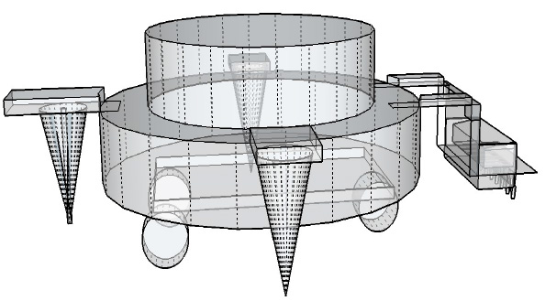
abstract
Nowadays, many expenses are made in the field of defense in adopting primitive security measures to protect the border from the trespassers. Some military organizations take the help of UGV in the risk prone areas which are not that effective when done by army men. Stanley is a Self-Concealing UGV that is equipped with modern technology that enables it to conceal itself by various methods in response to a threat from the enemy.

Slide 3
The UGV possesses camouflaging behavior by virtue of which it changes its colour and adapts itself to the colour of the surroundings, thus deceiving the enemy.
The UGV also has high power driven drillers that impart high torque to the system and make drilling easy.

Slide 4
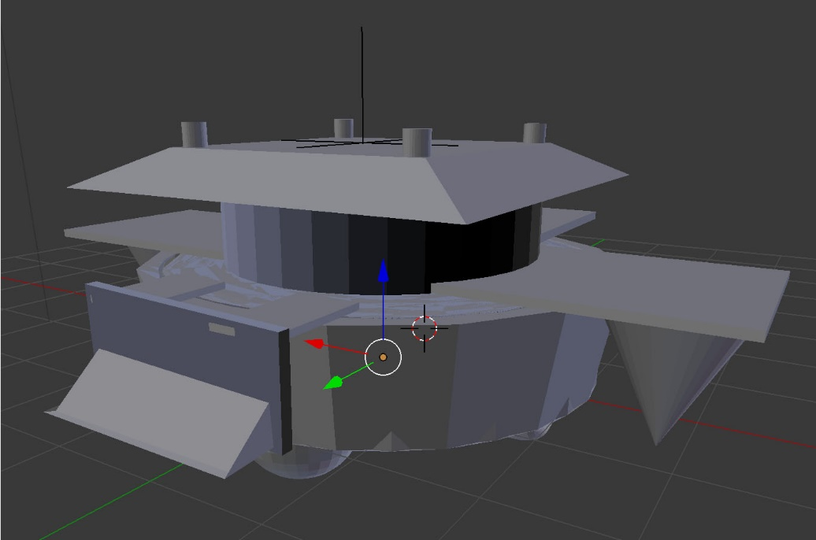
DESIGN
The UGV Stanley is designed to accomplish two tasks i.e. camouflaging and concealing with the help of digging. The upper circular cover part of the UGV is made transparent so as to depict camouflaging more effectively.

Slide 5
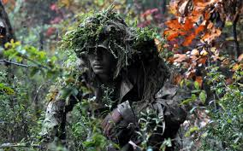
CAMOUFLAGING
Camouflage is the use of any combination of materials, coloration, or illumination for concealment, either by making animals or objects hard to see, or by disguising them as something else.

Slide 6
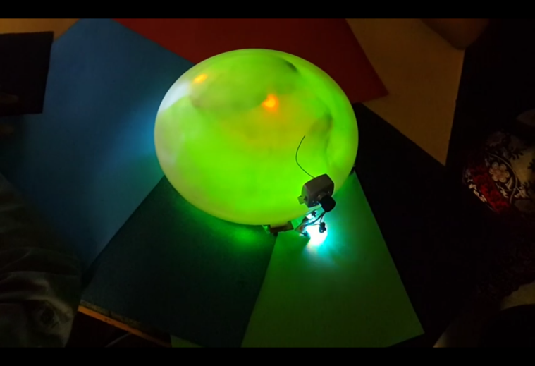
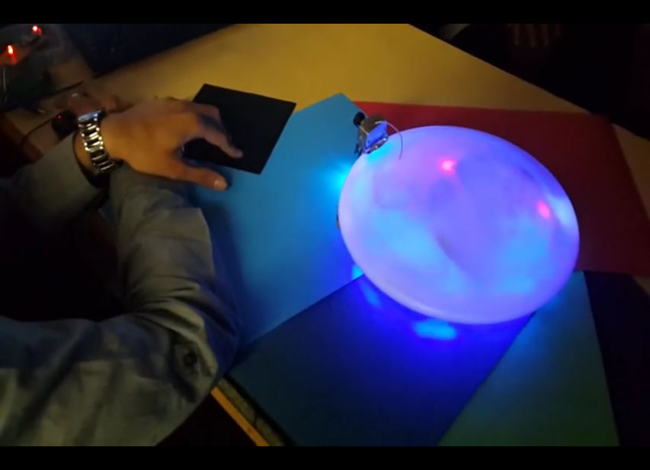
CAMOUFLAGING IN STANLeY
The UGV can adapt to the changes in the colour of the surroundings, with maximum efficiency and without any leakage of light energy from the robot.
The UGV has the capability to sense the temperature of the surrounding and can also camouflage thermally by adopting to the changes in temperature of the surroundings.

Slide 7
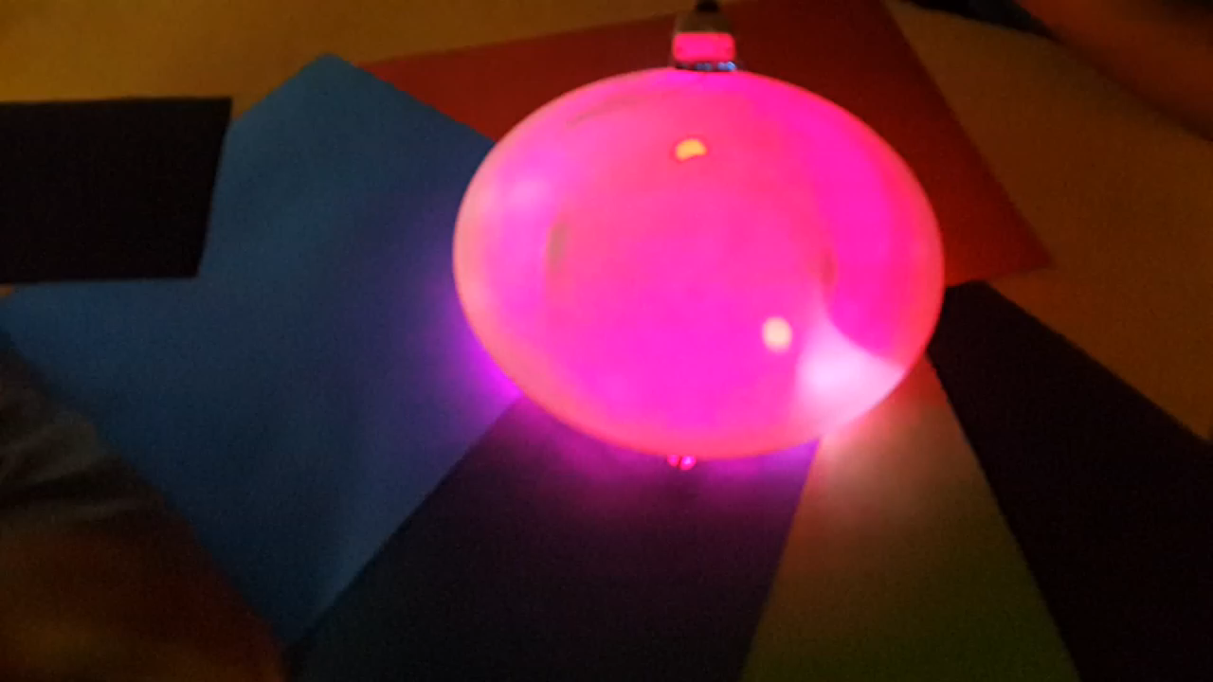

Slide 8
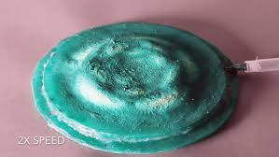
Mind the GLOW
Harvard University along with DARPA has developed a Silicone skin that can be well used to mask the glow of the LED’s.

Slide 9
Thermal Camouflaging
The temperature of the surrounding is analysed by thermostat, thermistor or RTD( Resistor Temperature Detector)
After the analysing of the temperature the inbuilt exhaust fans in the UGV radiate heat in and out from the UGV.
Study also suggests that it is possible to cool the robot by pumping in fluids through its different parts and the temperature of those fluids can be externally controlled.

Slide 10

MICRO-CONTROLLER
BLOCK DIAGRAM:
Heart of the UGV is a micro-controller.
Micro-controller is used for controlling all the operation done by the devices which are interfaced to it.
Micro-controller helps in transmission and reception of signals to be controlled.
AT89C52 IC is used in this micro-controller for driving the UGV.

Slide 11
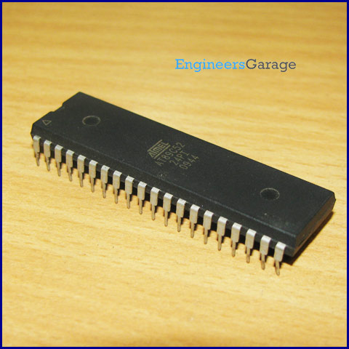
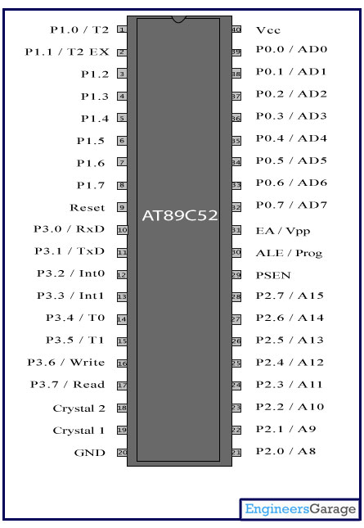
The IC used in this is AT89C52 has 40 pins.
This IC is a low power consumption IC having 8K byte of Flash memory and programmable memory.
It also has an on chip Flash memory used for reprogramming. Micro controller is provided with the power supply of 5V through the power supply circuit.
It has an additional crystal oscillator with clock frequency of 11.59MHz.
This IC can be easily interfaced.

Slide 12
COLOUR SENSOR
To analyze the colour of its environment, colour sensor is used.
The colour sensor used provides small size, low cost, easily compatible.
This colour sensor is small in size and integrated on a small module making wiring easy and also emits precise information of the neutral colour lighting of pure white.

Slide 13
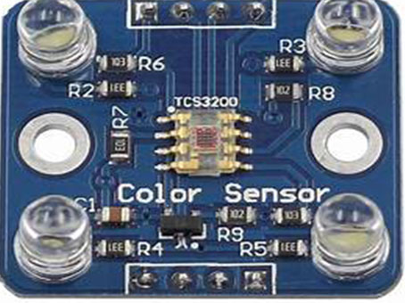
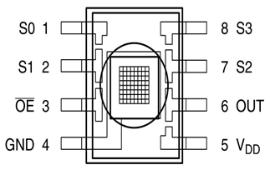
The operating principle of colour sensor is simple.
Photo diode is used to generate signal after reacting with the colour filter on receiving light reflected by ground.
The generated signal is analyzed in terms of frequencies and then gives ground colour.

Slide 14
PIR SENSOR
The PIR (Passive Infra-Red) Sensor is used to detect the changes made in the surrounding object by measuring the infrared levels made by the movement of object.
The high signal of the motion of object is detected on the I/O pin. PIR sensor is a pyro electric device.
The PIR sensor is a device which generates electric charge when exposed to infrared radiation and is made of a crystalline material.
An on-board amplifier is used to measure the changes in voltage generated that is obtained by the infrared on striking the object.

Slide 15
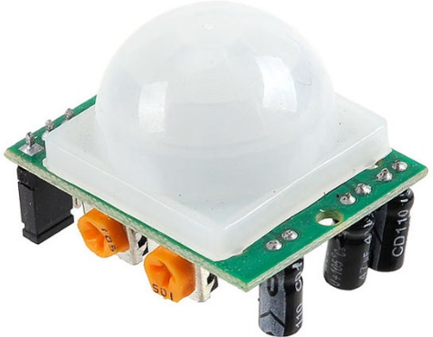
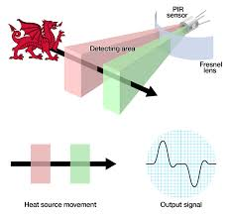
Fresnel lens is a special kind of filter used in this sensor which is used to focus the infrared signal onto the object.
In order to differentiate between the human and the animal movement we will use OMRON D6T series sensors .
This PIR sensor has a single bit output having small size that makes it compatible to all micro- controllers of 3V & 5V operation with less than 100uA current draw.

Slide 16
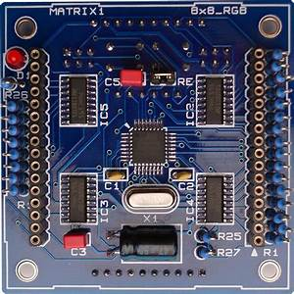
LED MATRIX
To display ground colours, 8x8 RGB LED matrix’s is being used. We used one matrix with one colour sensor which allows it to create a uniform colour zone.
Besides, these LED matrix’s have many benefits such as pins in 2*16 sets make it easier for wiring, their lightening quality (the UGV is used for the purpose of reproducing a colour rather than lightning up the environment), and a low power consumption.

Slide 17
BLOCK DIAGRAM
POWER SUPPLY
REMOTE
R
G
B
L
E
D
M
A
T
R
I
X
S
l
COLOUR SENSOR
MICROCONTROLLER
S
l
S
l
PIR SENSOR
MOTOR

Slide 18
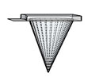
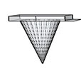
DRILLING
Drilling is done with the help of high power driven drillers.
These provide large amount of torque by taking a small amount of input power.
Drilling helps in loosening of the soil before it can be dug and thus it saves time.
The drillers in the UGV are symmetrically placed such that while operation the weight of the UGV stands balanced from all sides.

Slide 19
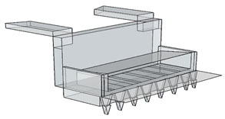
DIGGING
The digging process in the UGV is a simple lifting process as in the case of a bulldozer. The special type of 3 movable joint makes the lifting process easier as the Blade Lift Cylinder and the Tilt Cylinder can be simultaneously moved. The soil dug is collected in the Blade and can be discarded on the sides.

Slide 20
IMPLEMENTATION
The idea of the UGV Stanley is based on the camouflage techniques. The aim of the project is to design, manufacture and operate via a Smart phone, used as remote control device can reproduce the colour accordingly with the ground surface where it will be moving on, hence being camouflaged to the outside world.
So, in the Defense sector, such a UGV would allow the vehicles having large size to be camouflaged, in fact, Camouflage is essential in the army missions. Besides, in the Intelligence sector, we could use spying robots like drones.

Slide 21
THANK YOU

